Slide 1
REGIONAL
DDC Meeting
With your maars team
March 4, 2024

Slide 2
Agenda
Staffing Updates
State Reporting
Upcoming SIRS due dates
PD Reporting
Updates
3-8 Testing
Level 0 data timelines
Answer Sheets
Reason Not Tested Codes
Vendor Scoring
NYSAA Reminders
Level 1 Update and Survey
Regents
Algebra I Pre-ID Data Due Thursday, March 28
January scores L2RPT
June Regents

Slide 3
MAARS Coordinator
Ryan Maier
585-349-9010
Rmaier@bocesmaars.org
Old email will forward to this one
Any of my past resources you may have may need to be updated to fix One Drive linkage
Please let me know if you discover any link errors that you need fixed asap
eDoctrina Support Person
i-Ready, NWEA MAP until new Instructional Technology Specialist is onboarded

Slide 4
State Reporting

Slide 5
2023-2024 BEDS Day Enrollment & FRPL
BEDS Day Enrollment Extract (SIRS 312, 313, 314, 316, 319)
Enrollment by grade, district of residence and supplemental enrollment counts are collected for calculating preliminary State Aid allocations
BEDS Day Free and Reduced Priced Lunch Extract (SIRS-323 and SIRS-327)
Must be reported with 5817 – Free Lunch Program or 5806 – Reduced-Price Lunch Program
All must have 0198 – Poverty-from low-income family
Data due Thursday, March 14

Slide 6
2023-2024 UPK Collection Opens
The Office of Early Learning (OEL) will use a snapshot date of March 13, 2024 for this year's collection of UPK data
Change: For the 23-24 school year, UPK counts must reflect the actual UPK enrollment as of March 13
Data can be verified in SIRS-333 Annual Pre-K Enrollment Summary Report in the Annual Outcomes folder in L2RPT
Allocation lists for 2023-2024 can be found here: http://www.nysed.gov/early-learning/state-administered-prekindergarten-programs-allocations-and-financial-forms
Memo: https://www.nysed.gov/memo/early-learning/2023-2024-prek-child-counts-reporting-deadline-and-guidance-reporting-date-upk
UPK Counts data is due Thursday, June 6

Slide 7
2023-2024 Out of Certification Extract
Data collected for Official State teacher certification match & appears in NYS Report Card
SIRS Templates:
Staff Snapshot
Course Instructor Assignment (CIA) – teaching assignment
Student Class Entry/Exit (SCEE) – roster
L2RPT Verification:
SIRS-320 Staff Snapshot
SIRS-330 Student Class/Course Instructor Summary
SIRS-328 Out of Certification and SIRS-329 Staff Certification Reports to review teaching assignments
Resources:
2023-2024 Teacher Course to Certification Crosswalk (IRS Portal): maps each course to all certification areas that are approved to teach that course
NYS Comprehensive Course Catalog (http://www.p12.nysed.gov/irs/courseCatalog/): contains a list of state courses along with their state course code and brief description
Data due Thursday, May 16

Slide 8
CIA/SCEE and Student Daily Attendance
Data collected by Office of Accountability for student growth purposes
SIRS Templates:
Staff Snapshot
Course Instructor Assignment (CIA) – teaching assignment
Student Class Entry/Exit (SCEE) – roster
Student Daily Attendance through May 3
L2RPT Verification:
SIRS-320 Staff Snapshot
SIRS-330 Student Class/Course Instructor Summary
SIRS-360 Student Attendance Summary Report
SIRS-371 Student Attendance Count Report
SIRS-375 Student Attendance Count (by District) Report
Data due Thursday, May 16

Slide 9
PD Reporting

Slide 10
Please Welcome Our New PD Reporting & Frontline Support Personnel…
Jim Saintours

Slide 11
NEW: PD Reporting Web Pages!

Slide 12
NEW: Event Reporting Required for VR11, VR12
SPP Indicator 11 (VR11) and SPP Indicator 12 (VR12) Starting 23-24 SY:
REQUIRED reporting for ALL PUBLIC SCHOOL DISTRICTS every year (Previously on a 6-year reporting schedule)
Requires the Events for Indicator 11 – CPSE and CSE
Requires the Events for Indicator 12 – EI/CPSE
SPP Indicator 7 (VR15) - Still follows SPP Federal Indicator Reporting Schedule
Data due in Level 0: Thursday, September 5
Data certification due in PD Data System: Monday, September 9
Please note the accurate certification button for both the VR11 and VR12 will not become available until the first week of June 2024
Click here to retrieve this table from the EOY PD Reporting web page
Notes:
You can find the most recent version of the EOY VR reporting table on the End of Year page of the PD Reporting/MAARS website.
It can be found on the right side of the screen in the ‘Help Guide Downloads’ area

Slide 13
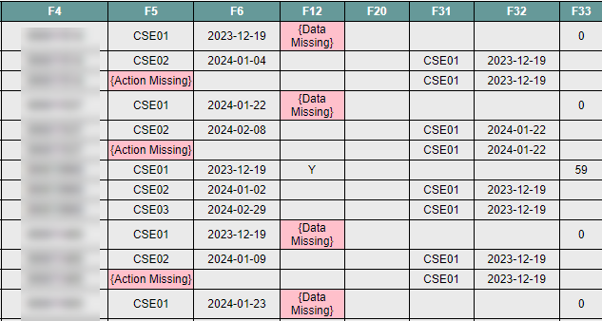
NEW: Event Reporting Required for VR11, VR12
Incomplete SE Event records can now be uploaded to Level 0 without encountering an import error in Level 0
Frontline IEP will export a student’s Events, even if the record contains a {Data Missing} or {Action Missing} field.
Notes:
Events no longer need to contain all data fields in order to upload to Level 0, which means you can upload Events at any time! Including today!!
Touch base with your SPED department to setup a regular upload schedule.

Slide 14
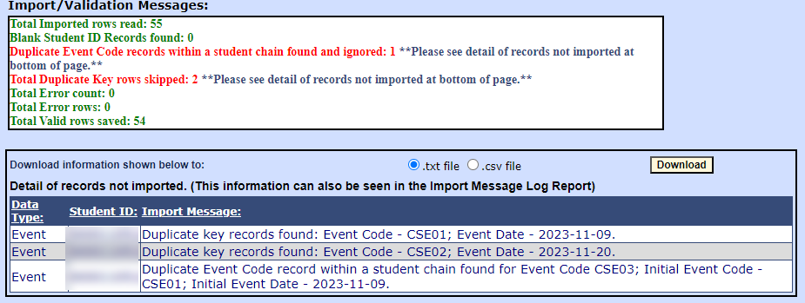
NEW: Event Reporting Required for VR11, VR12
If you get an import error in Level 0, then it’s related to other issues, such as duplicate Events, but will still allow one set of Events to upload. Follow up with SPED department so they can make the changes in the Process Tracking log.

Slide 15
Questions?
Notes:
Reminder: Send only student ID If using screen shots, please blur out names. We can help you with how to do this if you need assistance.

Slide 16
Level 0

Slide 17
Level 0 and ASAP Webserver
During the week of February 20-24 we moved the following applications to a new server
Level 0
Level-0 Test
ASAP
We thank you all for your patience while these applications were unavailable during this time
Please contact Matt Fredericks if you experience any issues with any of these applications
Upgrades
Level 0 and Level-0 Test were upgraded to 18.02
ASAP was upgraded to 4.0.14

Slide 18
SED Testing Updates

Slide 19
3-8 Testing - ELA, MATH, SCIENCE, NYSESLAT PBT and CBT

Slide 20
3-8 Testing - General Reminders Concerning Reason Not Tested Reporting (PBT)
Administrative Error: a 2-step reporting process which includes both a letter written by the principal sent to NYSED & a student answer sheet bubbled as Administrative Errors sent in for processing.
Medically Excused: an answer sheets must be submitted for processing with Medically Excused bubble for that student.
Absent or Refused entire test: Both Session 1 AND Session 2 reason not tested must be bubbled in on the student answer sheet and sent in for processing.
Absent for test (or any part) and completes test during make- ups: Make sure to erase the absent bubble before sending in for processing.

Slide 21
Ordering Paper Answer Sheets for CBT Students (CBT)
CBT students that need to take the paper version of the test... must have an IEP/504 stating they require paper testing.
CBT paper answer sheets request forms(Excel) were posted on our SFTP site January 30th along with directions. All answer sheet request forms should have been into to us by February 16th.
However, schools that find they will need additional paper answer sheets printed (but had not completed an order form) should contact me directly. I will then send you the appropriate blank Excel order form to complete (inlcuding form directions). Please do not wait until the last minute before testing to order additional answer sheets.
Our goal is to have all answer sheets printed and shipped out (districts) and ready for pick-up (Charters & Non-Public) before the testing window opens April 8th.
Delivery and pick-up dates coming soon
Test booklets should have already been ordered for these students during the
NYSED assessment ordering window.
If you need additional test booklets, you can still order them directly through NWEA.
Contact Info. --> 1-866-997-0695 or NYTesting@nwea.org
If you have any questions or concerns, please do contact me.

Slide 22
ADDING 7th GRADE STUDENTS TO GRADE 8 SCIENCE VIA NEXTERA ADMIN (CBT)
NYSED has posted an article to CBT Support concerning grade 7 students taking Science 8 CBT:
This article talks about the adding of 7th graders to Nextera that need to take the grade 8 Science. (see link to article below)
Adding Grade 7 Students to Grade 8 Science
Any questions, please contact Mari-Ellen Maloney
mmaloney@bocesmaars.org or 585-349-9025

Slide 23
CBT 8th Grade Students Taking Regents (CBT)
If you have 8th grade students loaded into Nextera that are taking Regents instead of taking Science 8 and/or Math 8:
Please remember to enter a reason not tested of “Taking Regents” into Nextera for that students Science 8 exam and/or Math 8 exam.
Note: If the 8th grade Regents student was not loaded into Nextera, you do not need to enter the student into Nextera just to give them an RNT of "taking regents.

Slide 24
CBT Student Accommodations (CBT)
NEW 2023-24: Setting Student Testing Accommodations for CBT - Quick Reference Guide
There is a quick reference guide, at the bottom of this article, that you can print out to help with setting accommodations.
Multi-Student Setting of Accommodations (Multi Student Edit):
Please keep in mind, When setting accommodations for multiple students simultaneousely.
Multi-Student Edit will overwrite any previously assigned student individual accommodations
Best practice is to set all your Multi-Student Accommodations first then add any individual student accommodations where needed.

Slide 25
3-8 Testing - General Reminders Concerning Reason Not Tested Reporting (CBT)
Administrative Error: a 2-step reporting process which includes both a letter written by the principal sent to NYSED & entering the reason not tested into Nextera Admin.
Remove session absent when student has completed that session of the test.
Students that have a not tested code and have answers on that test session; that test may not receive a final score.
Students that are enrolled at time of test but did not complete the test must have a not tested code “reason” entered in each of their session status for the test not completed.
Review all sessions status, look for any incomplete sessions or sessions still in progress.
These need to be investigated and resolved before the testing window closes.

Slide 26
3-8 Testing – General Reminders Concerning Reason Not Tested Reporting (CBT)
NOT TESTED CODES FOR OPERATAIONAL 2024 TESTING – in NEXTERA ADMIN:
(deadline to complete and finalize all student session(s) not tested code entries in NEXTERA ADMIN.)
(Includes a helpful CBTsupport article & document)
ELA, MATH and SCIENCE --- March 25th thru May 24th (Nextera Will Close May 24th)
PLEASE make sure your CBT schools are aware of this date! Once we get it to you.
This is the last opportunity they will have to update/review their student’s Not-Tested Reason entries into NEXTERA!
Please also remember it is the district/school’s Test Coordinator’s responsibility to make sure these are accurate before the deadlines.
Missing a reason not tested could cause the student not to get a final score on the part of the test they may have completed.
Helpful CBTsupport article and document: NEW 2023-24: How to Set Not Tested Codes - Quick Reference Guide
Please read through this article and Quick Reference Guide)(at the bottom of
It will show you how to down-load the Test Status Detail Report from NEXTERA.
It is very important that each school down-load the Test Status Detail report to review the students’ test status for all sessions, make any needed additions or corrects to the reason not tested before the test window closes. Keep in mind there are 2 sessions for ELA and Math. Both session may or may not need a reason not tested.
This report will also help identify any student that may not have completed the test (Exp: Absent) that will need to sit for a make-up, before the testing window closes.
Once all make-ups are done and all Not Tested Reasons have been updated, it is strongly recommended that the district/school Test Coordinator down-loads a final copy of the Test Status report file and keep it as a reference. As this will be the only reference, they will have on their student test status once NEXTERA closes.

Slide 27
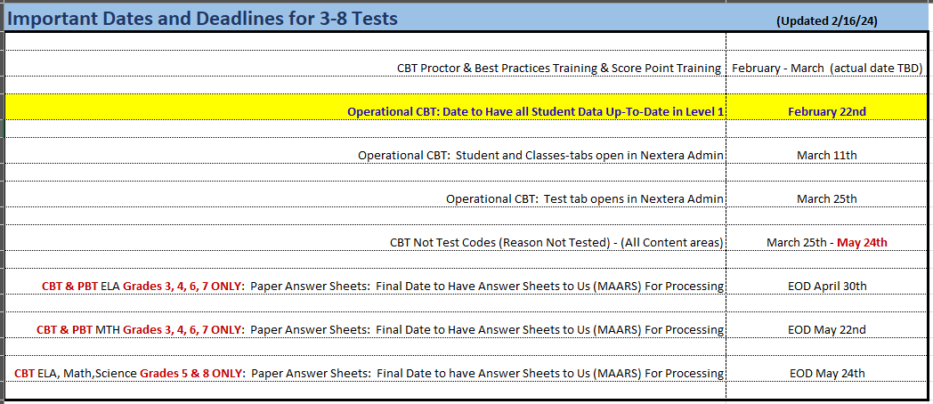
Important Dates both PBT & CBT

Slide 28
3-8 Testing – Questions?

Slide 29
NYSAA

Slide 30
NYSAA (Alternate Assessment)
Test Window March 11 - June 7
All teachers should have already completed:
Required Annual Administrator Training
New: Self Directed option located on Kite Educator Portal
First Contact Survey and Personal Needs and Preferences for each student
Questions or concerns, reach out to Lorena lstabins@bocesmaars.org
Special Circumstances Codes must be entered before window closes
Information on Special Circumstances Codes (Medically Excused, Absent, Parent Refusal, etc.)
Questions, reach out to Mari-Ellen mmaloney@bocesmaars.org

Slide 31
Level 1

Slide 32
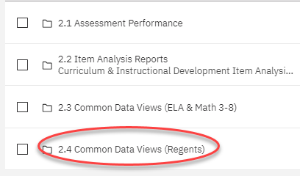
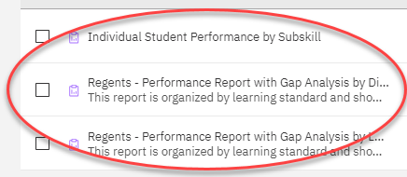
Item Analysis for January 2024 Regents Now Available

Slide 33
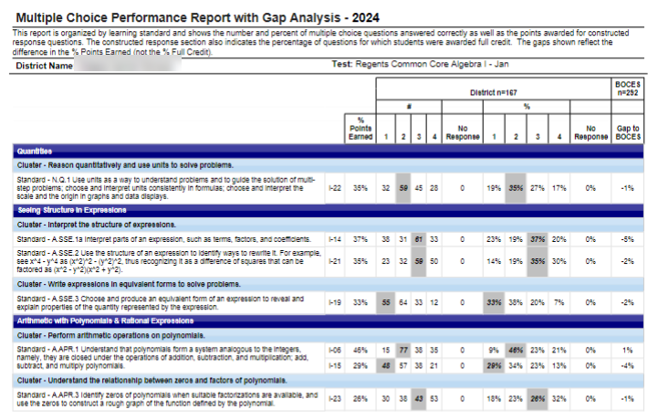
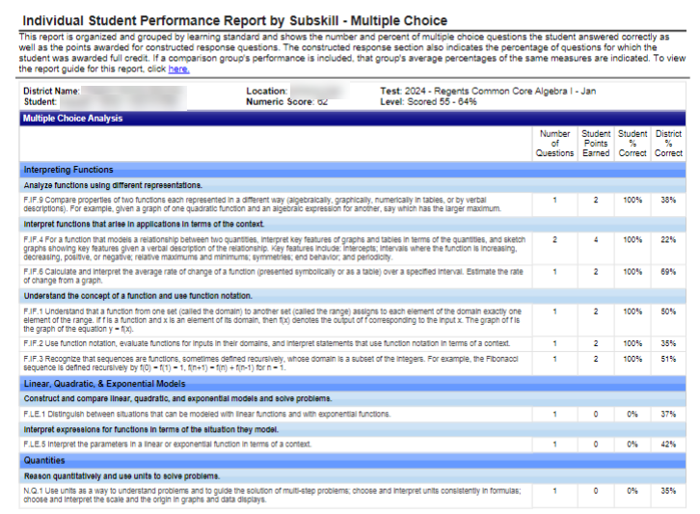
Example of Jan Regents Reports Mapped to Standards

Slide 34
Please Complete a Brief Survey to Give Us Valuable Feedback Related to Level 1 Data Warehouse (by Friday, March 8th)
Link to Brief Survey

Slide 35
Regents

Slide 36
Algebra I Special Collection Pre-ID File
Schools selected for Pearson's Special Collection will receive a letter from OSA on Wednesday, March 13
Schools chosen will use answer sheets from Pearson for the June Algebra I Regents
The state will provide Pearson with Pre-ID File that will be used to preprint answer sheets
Pre-ID File Data is due Thursday, March 28
Demographic
Enrollment
Course Instructor Assignment
Student Class Entry/Exit
Students in courses with the following State Course Codes will be pulled for Pre-ID File
Algebra I 02050
Algebra I 02052CC

Slide 37
JANUARY REGENTS
January Regents scores have been loaded to Level 2
Please verify all information is accurate.

Slide 38
REGENTS
Pertinent information (including the highlights below) have been updated in the MAARS website .
Ordering Exams with the Office of State Assessment by April 12th.
M.A.A.R.S. Pre-printed answer sheets:
MAARS order form for preprinted answer sheets due April 9th
Files of student demographic information is due April 16th to MAARS through the secure Monroe FTP site. Please do not email files of student information!
Any needed additional walk-in files are due June 7th and will continue to be accepted by MAARS up to exam time. Last minute answer sheets will be printed to a PDF file and sent to the school for printing.
Do not make copies of pre-printed or blank answer sheets for students to use.
MAARS will start preprinting answer sheets in the first week of May. They will be shipped to Districts/BOCES starting by May 24th. We will notify the other schools when their answer sheets are ready to be picked up at MAARS.
Any questions, please contact Patty Zeiner 349-9053 or pzeiner@bocesmaars.org

Slide 39
Questions?

